Slide 1
1
Define Problem Zone
Solution
Parametric
Linear Regression
Problem
Univariate
Non-parametric
KNN, RF, DT, SVM
Regression (Continues Output)
Parametric
Polynomial Regression
Multivariate
Non-parametric
KNN, RF, DT, SVM
Supervised Learning
Parametric
Logistic Regression
Binary-class
Non-parametric
KNN, RF, DT, SVM
Classification (Discrete Output)
Parametric
MLP
Multi-class
Non-parametric
KNN, RF, DT, SVM

Slide 2








2
Solution Model
Linear Regression
Parametric solution
Y
y = m x + b
k
x
y
e4
500
$$\hat{y}$$
e5
y = w₀ + w₁ x ---> (1)
y
Area | Price (k)
100 | 200
150 | 400
200 | 450
250 | 550
300 | 450
e3
400
$$\hat{y}$$
e2
Error
300
$$\hat{y}$$
$e=\hat{y}$ - y
e1
200
$$e1+e2+e3+e4+e5$$
100
$E=\sum_{i=1}^{n}{\text{(}\hat{y}\text{ −} \text{y}\text{) }→(2)}$
X
50
50
50
100
100
150
150
150
200
200
200
250
$$m^{2}$$
250
300

Slide 3
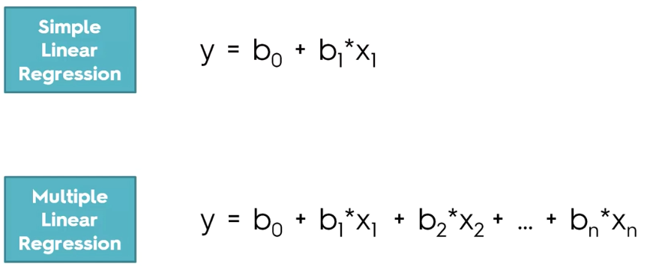

Slide 4
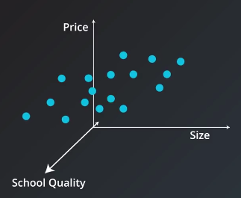
2
Solution Model
Linear Regression
x1
x2
y
y = w₀ x₀ + w₁ x₁ + w₂ x₂
Area | Num of Rooms | Price (k)
100 | 2 | 200
150 | 3 | 400
200 | 4 | 450
250 | 5 | 550
300 | 7 | 450
Num of Rooms

Slide 5


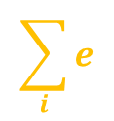
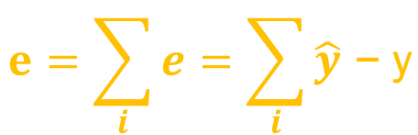

2
Solution Model
Linear Regression
y = w₀ x₀ + w₁ x₁ + w₂ x₂
Y
w₀
w₁
w₂
e3
$$\sum_{i}{e}$$
e2
e1
$$\hat{y}$$
y
$$\hat{y}$$
y
$$\hat{y}$$
y
X
$$e=\sum_{i}{e}=\sum_{i}{\hat{y}\text{ − }\text{y}}$$

Slide 6
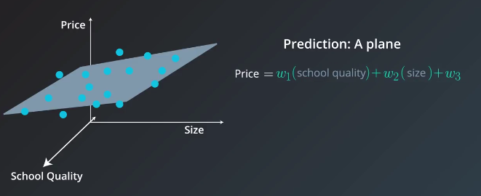

Slide 7
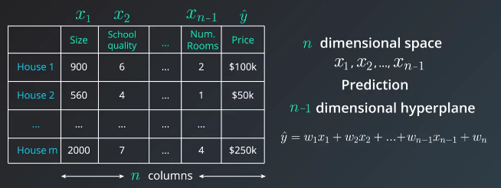

Slide 8
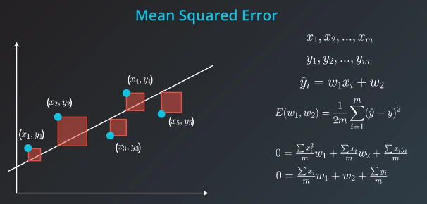

Slide 9

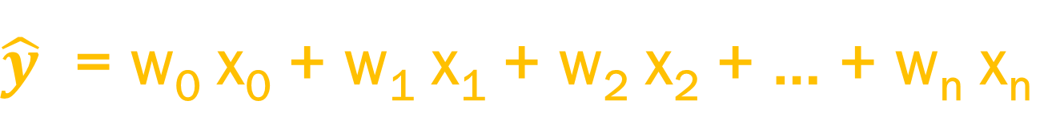
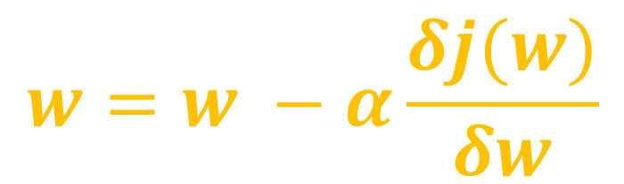
$\hat{y}$ = w₀ x₀ + w₁ x₁ + w₂ x₂ + … + w_{n} x_{n}
Linear Model
$$J(W)=\frac{1}{n}\sum_{i}{{(\hat{y}\text{ − }\text{y})}^{2}}$$
Cost Function
$$w=w −α\frac{δj(w)}{δw}$$
Gradient Descent

Slide 10
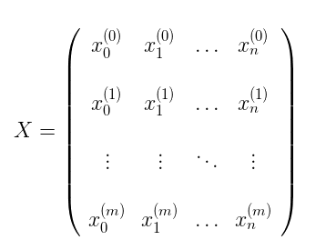
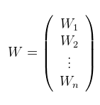
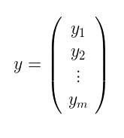

Slide 11
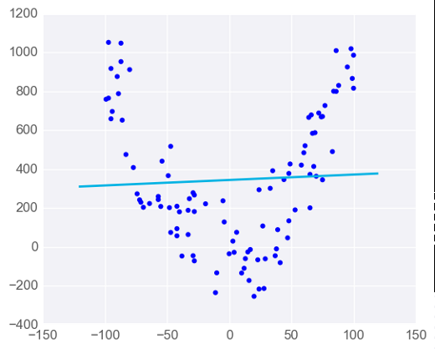
Linear Regression Warnings
Linear Regression Works Best When the Data is Linear

Slide 12
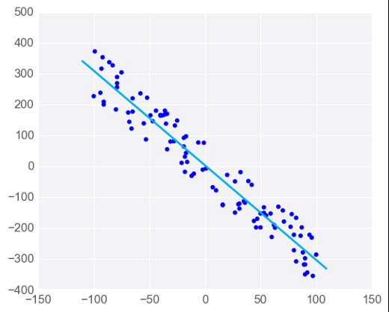
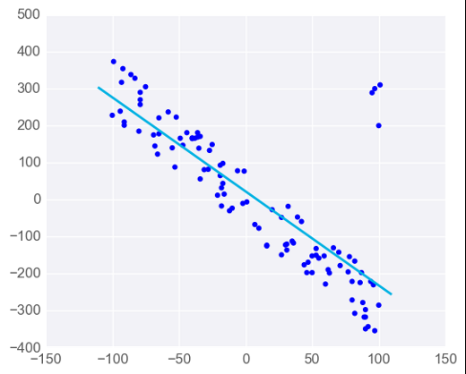
Linear Regression Warnings
Linear Regression is Sensitive to Outliers

Slide 13
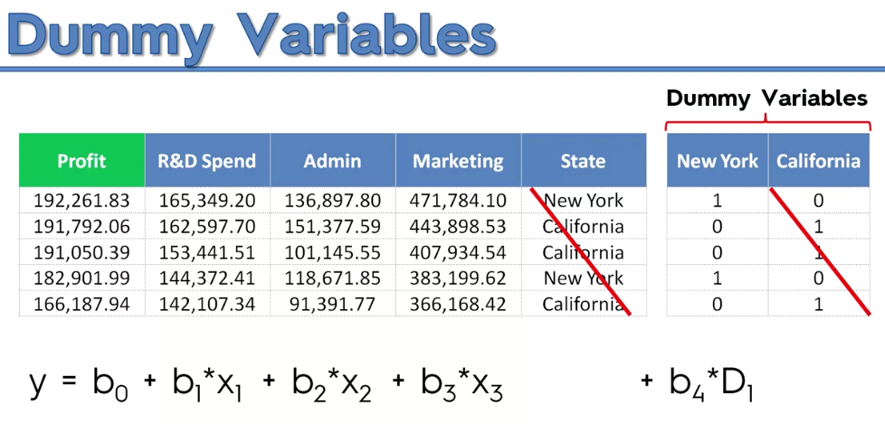

Slide 14
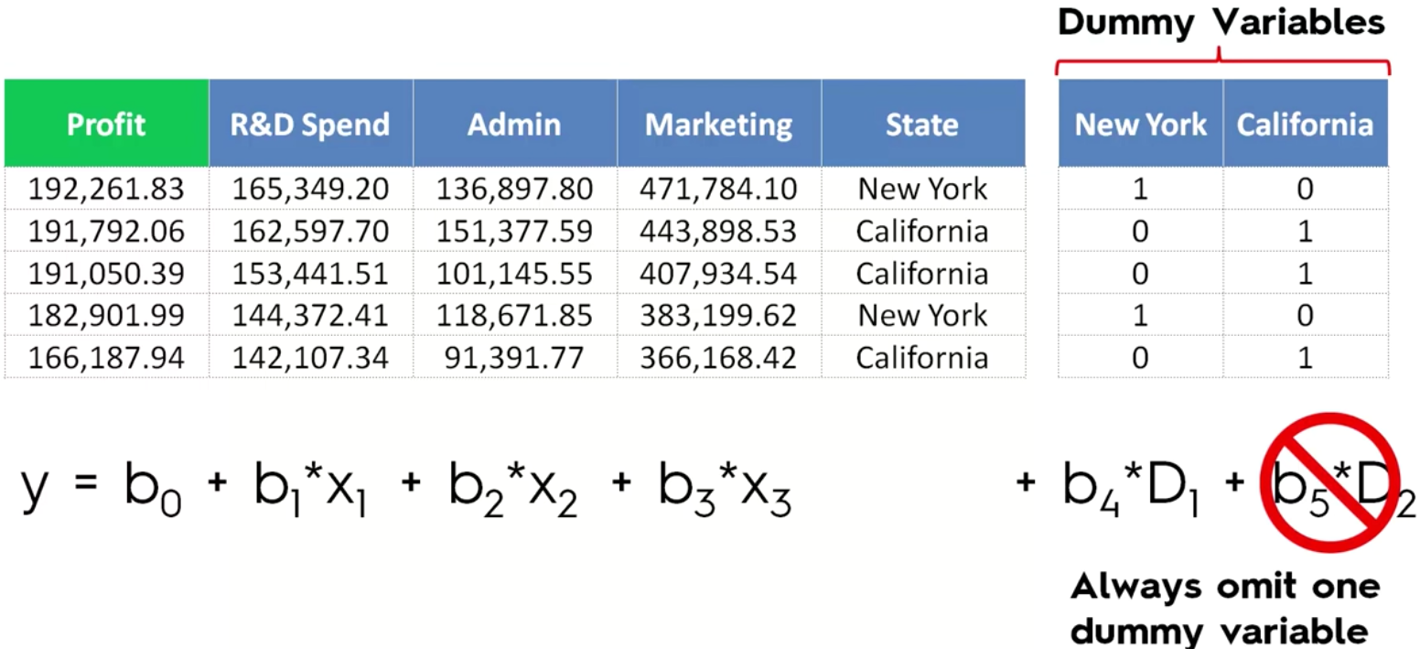

Slide 15
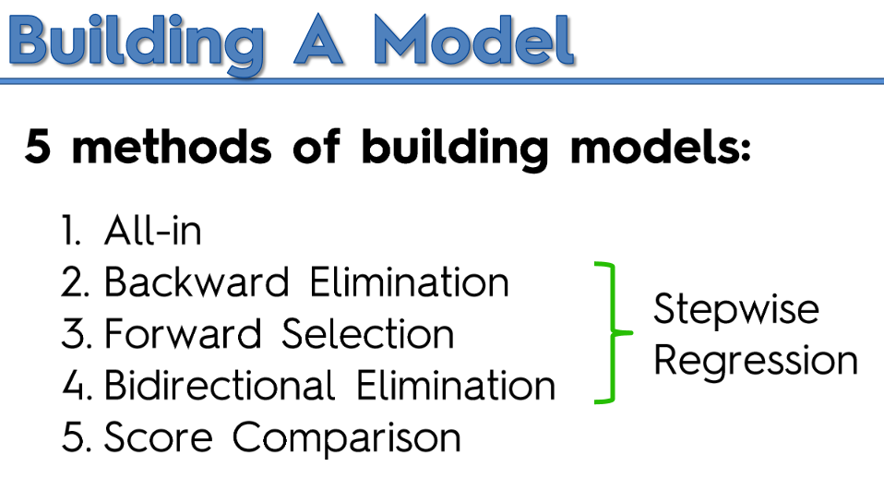

Slide 16
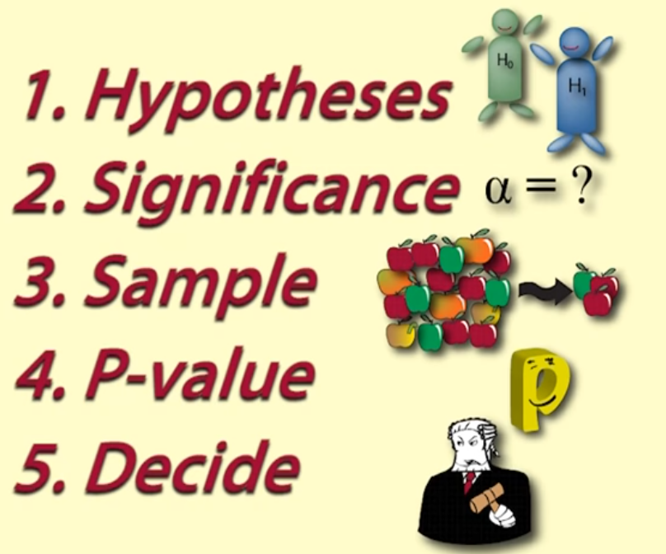

Slide 17
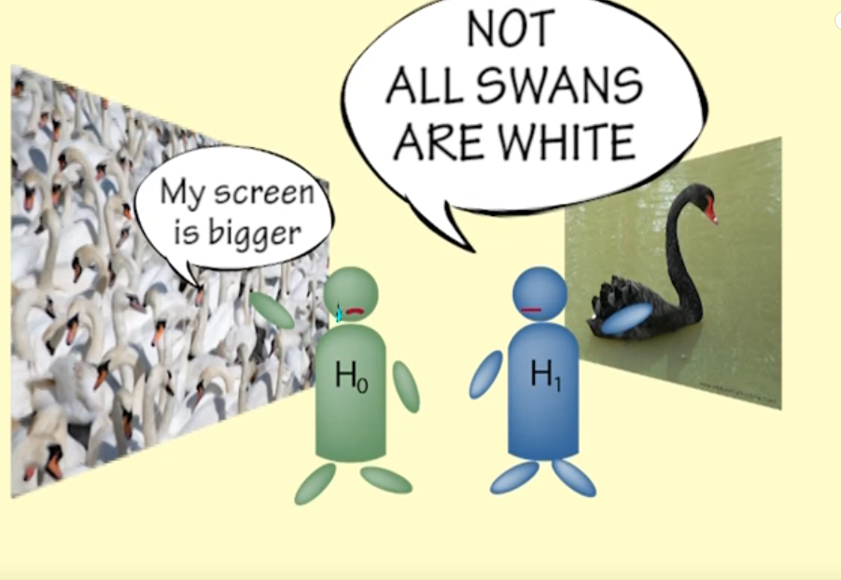
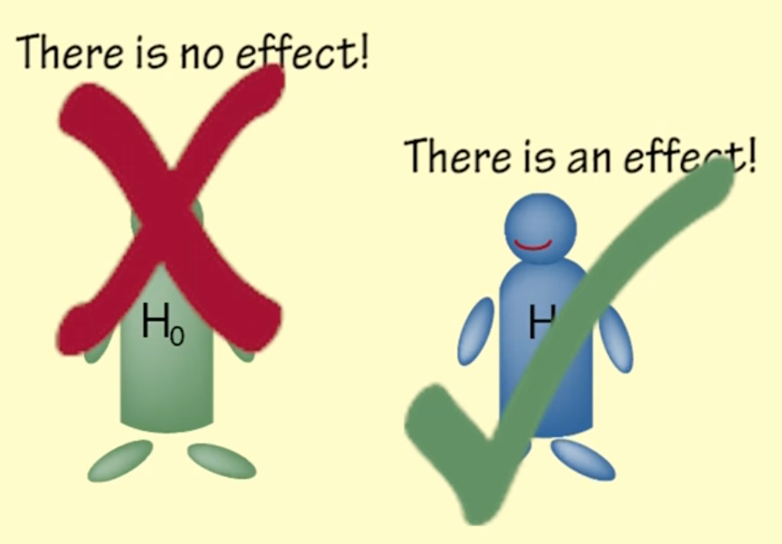
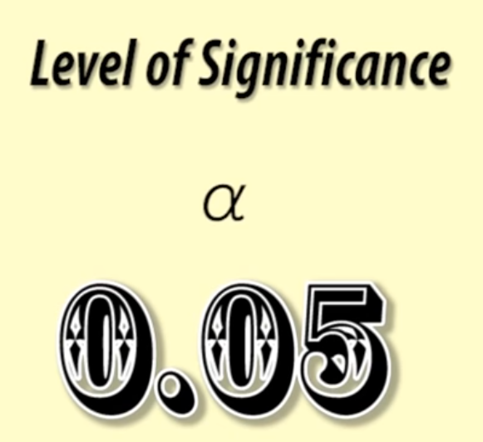

Slide 18
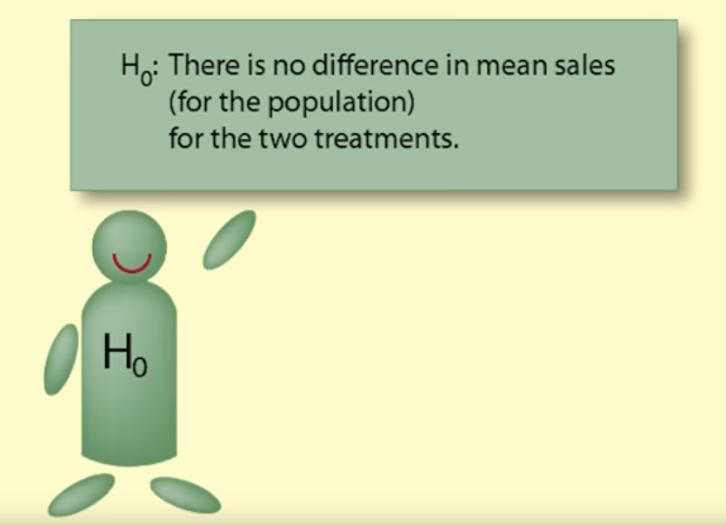
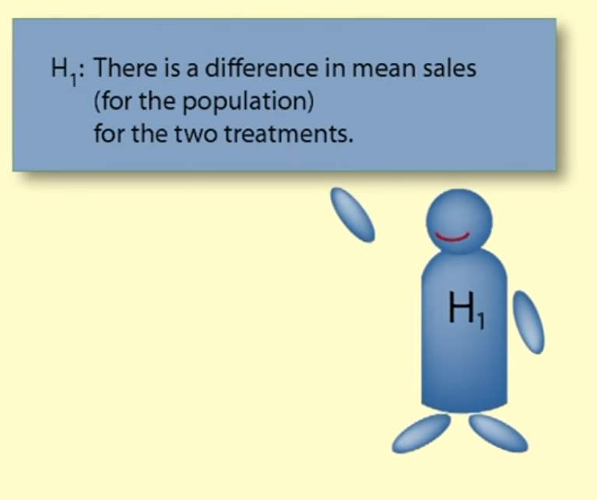

Slide 19
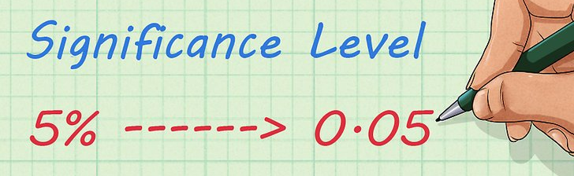
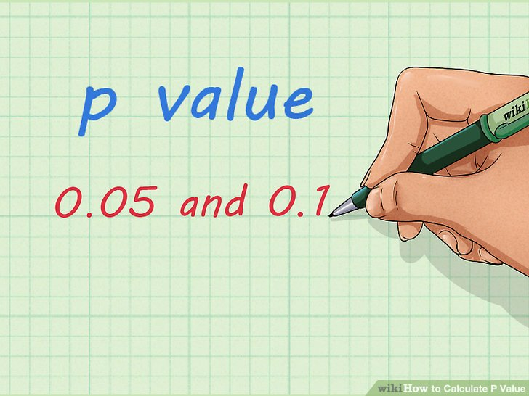
Feature Engineering and P - Value
P value is a statistical measure that helps scientists determine whether or not their hypotheses are Statistically Significant or not
if the P value of a data set is below a certain pre-determined amount (like, for instance, 0.05), scientists will reject the "null hypothesis" of their experiment

Slide 20
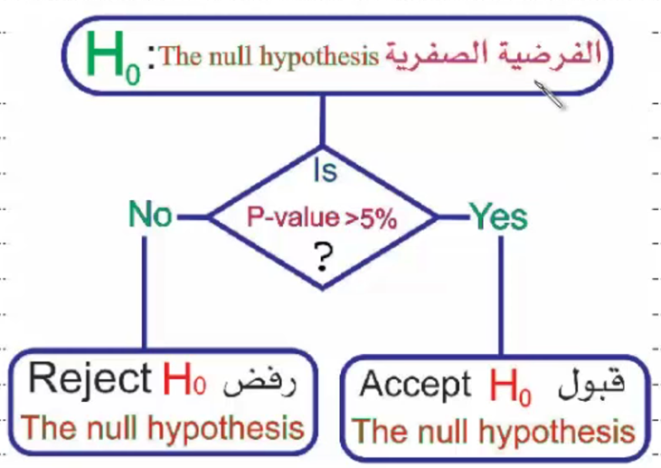

Slide 21
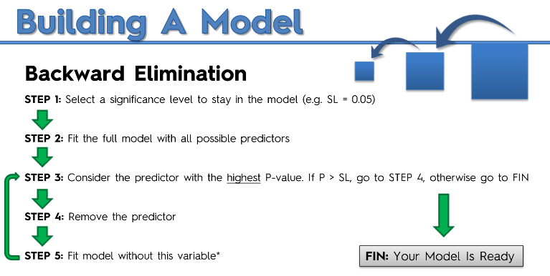

Slide 22
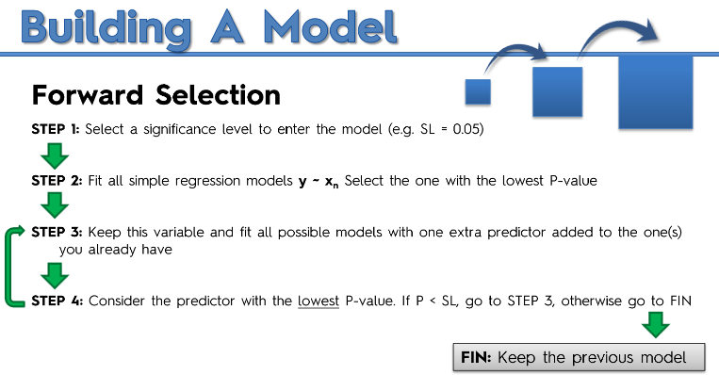

Slide 23
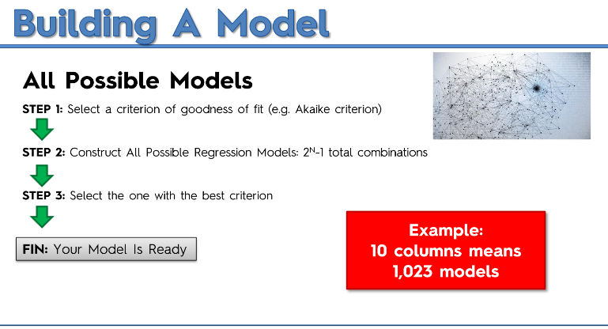

Slide 24
